Slide 1
Inductive Bias
It is the set of assumptions a machine learning algorithm makes to learn or generalize from limited data. It helps the algorithm make predictions on new, unseen data.
It guides the learning process by narrowing down the possible solutions to focus on those that are more likely to be correct based on the model’s assumptions.
It helps a model generalize from the training data to new data. The goal is for the bias to align with the true patterns in the data, so the model makes good predictions.
Example: When you assume that people of similar age have similar buying habits, you are using an inductive bias. It’s a guess or assumption that helps predict their future behavior based on limited data.

Slide 2
Assumptions Shape Learning: Inductive bias reflects the assumptions a model makes about how data behaves, guiding its learning process.
Improves Efficiency: Inductive bias helps algorithms learn faster by focusing on patterns that align with the model’s assumptions, saving time and computation.
Cannot Avoid It: Every machine learning model has some form of inductive bias, whether we design it intentionally or not.
Strong vs. Weak Bias: Strong inductive bias means the model makes stronger assumptions and is more restrictive.Weak inductive bias means the model is more flexible, but this increases the risk of overfitting.
Inductive Bias in Everyday Life: Even humans use inductive bias, like when you assume it will rain because the sky is cloudy.
Crucial for Small Data: Inductive bias is particularly important when you have small datasets, as it helps the model make better predictions with limited information.

Slide 3
Hypothesis Space
It is the set of all possible models or solutions that a machine learning algorithm can choose from to explain the data.
The goal of machine learning is to find the best hypothesis (model) from this space that fits the data well.
Different algorithms have different hypothesis spaces. For example, linear regression's hypothesis space contains all possible straight lines, while decision trees have all possible tree structures.
If the hypothesis space is too large, it can make learning difficult because there are too many possibilities to choose from.
If it’s too small, the model might not capture the complexity of the data and could perform poorly.

Slide 4
The learning algorithm searches the hypothesis space to find the one that minimizes errors and makes good predictions on new data.
A simple model (like a straight line) has a smaller hypothesis space, while a complex model (like a deep neural network) has a much larger hypothesis space.
The goal is to choose a hypothesis that generalizes well to new data, not just the training data.
The inductive bias of an algorithm affects the hypothesis space. A strong bias restricts the hypothesis space to simpler solutions, while a weak bias allows more complex solutions.
For a problem like predicting house prices, the hypothesis space could contain all possible equations or patterns that relate features (like size, location) to the price.

Slide 5

Cross Validation

Slide 6
Cross Validation

Slide 7
1. K-Fold Cross-Validation
Dataset is divided into K equal-sized subsets or folds.
The model is trained K times, each time using K−1 folds for training and the remaining fold for testing.
Advantages:
More Reliable Evaluation:
Reduces Overfitting:
Disadvantages:
Computationally Intensive:

Slide 8
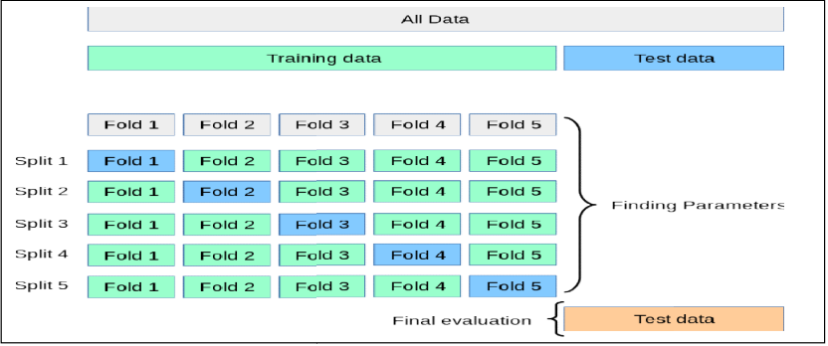
Working K-Fold
Steps:
1. Divide Data: Split the dataset into K folds.
2. Train and Test: For each iteration, train the model on K−1 folds and test it on the remaining fold.
3. Repeat: This process is repeated K times, with each fold serving as the test set exactly once.

Slide 9
2. Leave One Out Cross Validation
In LOOCV, the model is trained on all but one data point and then tested on that single omitted data point. This process is repeated for each data point in the dataset.
Advantages:
Low Bias: Uses almost all data points for training, so it has low bias and makes good use of available data.
Disadvantages:
High Variance: Testing on just one data point can result in high variability, especially if the data point is an outlier.
Computationally Expensive: Requires training the model as many times as there are data points, which can be time-consuming for large datasets.

Slide 10
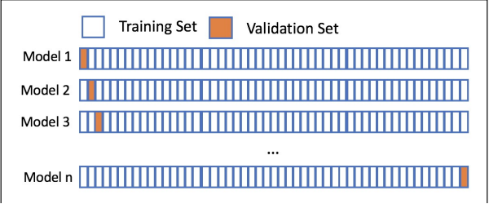
Working: LOOCV
Split data in N samples
Train the model on N-1 samples.
Validate model
Repeat
Compute error

Slide 11
3. Leave-p-Out Cross-Validation
Involves splitting the data such that p samples are left out as the test set & remaining samples are used for training.
Process repeats possible combinations of p
Advantages:
Comprehensive Evaluation of p samples, providing a thorough assessment of model performance.
Disadvantages:
Computationally Intensive large datasets and when p
Test Set Overlap: Unlike LOOCV and K will overlap if p is greater than 1.

Slide 12
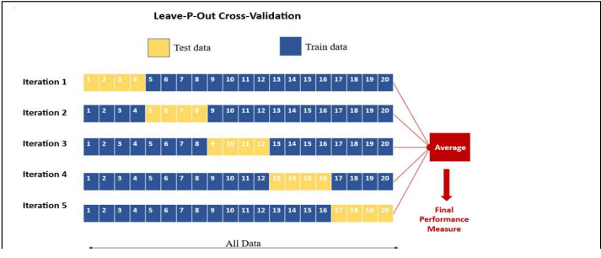
Working: LPOCV
Steps:
Divide Data: Create all possible combinations of
Train and Test: Train the mod p samples.
Repeat: This process is performed for every possible combination of samples

Slide 13

Bayesian Method

Slide 14
Bayesian Method
The Bayesian method is based on Bayes' Theorem, which describes the probability of an event based on prior knowledge of conditions related to the event.
In machine learning, it involves updating the probability estimate for a hypothesis as more evidence or data becomes available.
P(A|B) = (P(B|A) * P(A)) / P(B)
where:
P(A|B) is the probability of event A occurring given that B is true.
P(B|A) is the probability of event B occurring given that A is true.
P(A) is the probability of event A.
P(B) is the probability of event B.

Slide 15
Bayesian Method
Prior (P(A)): This is the initial judgment or belief about the probability of an event before new data is introduced.
Likelihood (P(B|A)): This is the probability of observing the new data under the assumption that the prior and the model are true.
Posterior (P(A|B)): The updated probability of the event after considering the new data. The posterior becomes the new prior if more data becomes available, allowing for continuous updating of our belief.

Slide 16
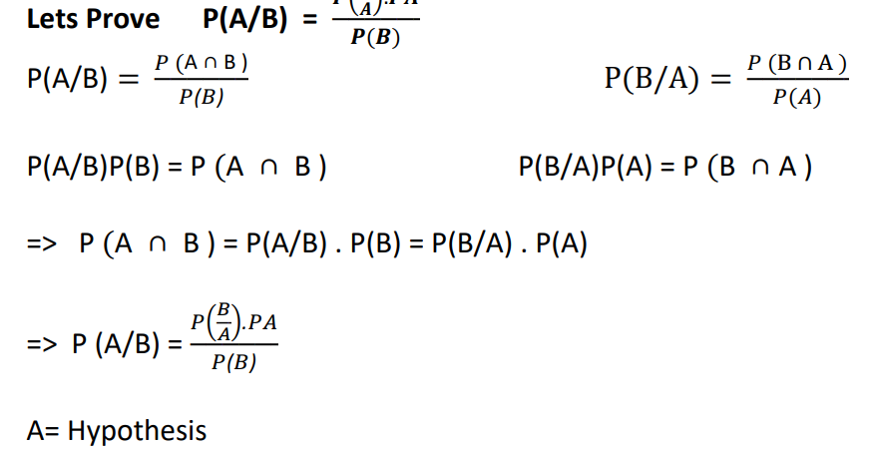

Slide 17
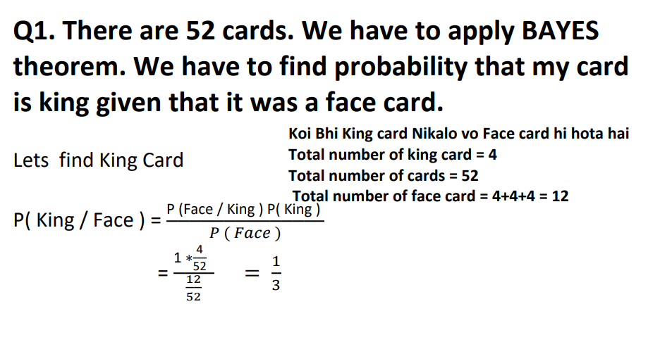

Slide 18
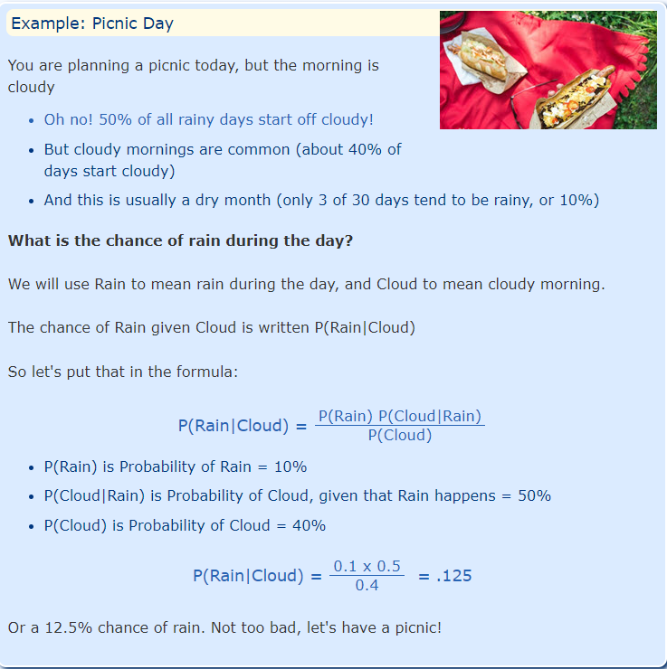

Slide 19
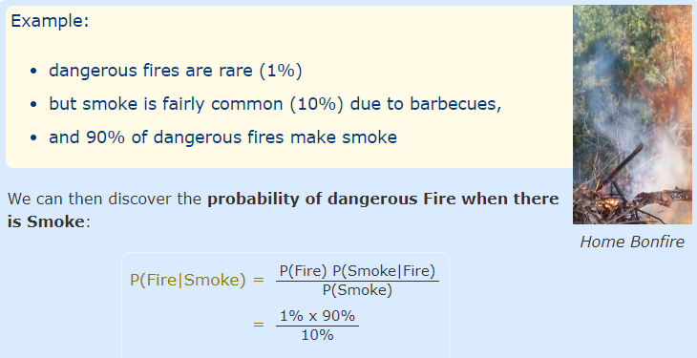

Slide 20
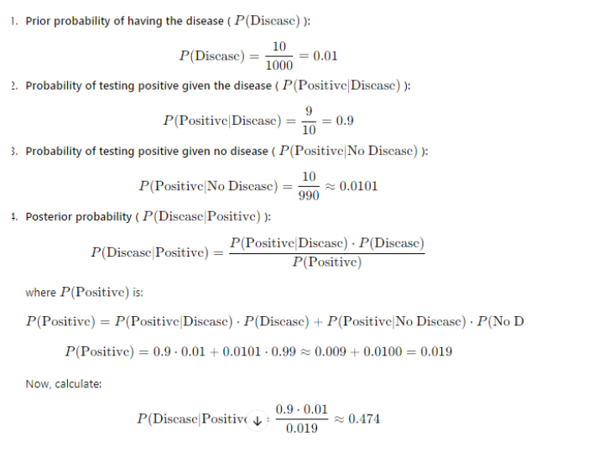
Q1. Imagine there are 1000 people in a town, and 10 of them have a particular disease. There
is a test for the disease that correctly identifies the disease in 9 out of 10 people who have it.
However, it also incorrectly identifies the disease in 1 out of 100 people who do not have it. If
a person tests positive, what is the probability that they actually have the disease?
Hint: Use Bayes' Theorem with the following:
○ Number of people with the disease: 10
○ Number of people without the disease: 990
○ Number of true positives: 9
○ Number of false positives: 10

Slide 21
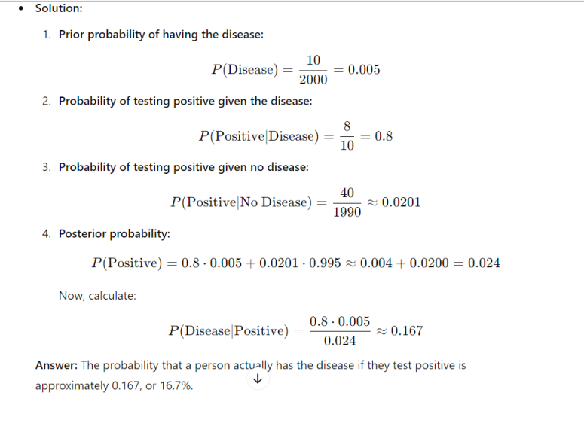
Q2. Out of 2000 people in a city, 10 have a certain disease. A test is available that correctly
identifies 8 out of 10 people who have the disease and incorrectly identifies 1 out of 50
people who do not have the disease. If someone tests positive, what is the probability that
they actually have the disease?
Hint: Use Bayes' Theorem with the following:
○ Number of people with the disease: 10
○ Number of people without the disease: 1990
○ Number of true positives: 8
○ Number of false positives: 40

Slide 22
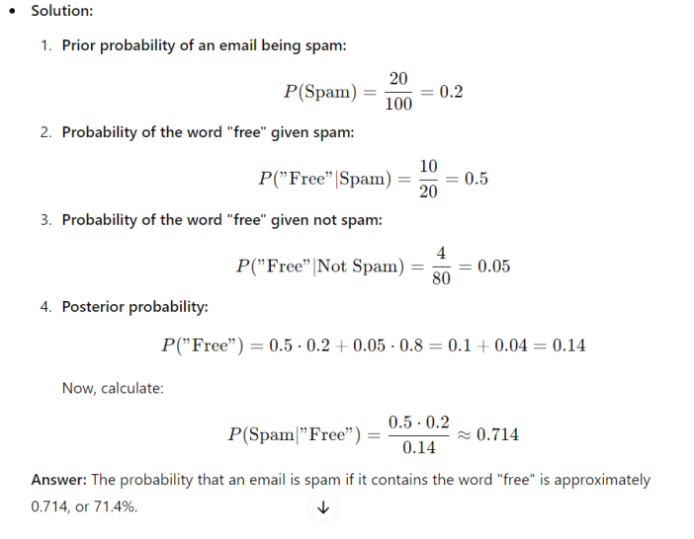
Q3. Imagine you receive 100 emails, and 20 of them are spam. The word "free" appears in 10 of
the spam emails and in 4 of the non-spam emails. If an email contains the word "free," what
is the probability that it is spam?
Hint: Use Bayes' Theorem with the following:
○ Number of spam emails: 20
○ Number of non-spam emails: 80
○ Number of "free" in spam: 10
○ Number of "free" in non-spam: 4

Slide 23
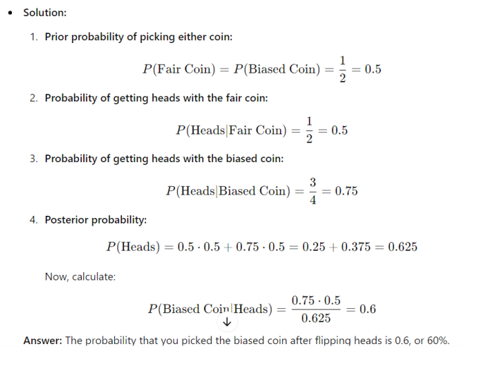
Q4. You have two coins. One is a fair coin, and the other lands heads 3 out of 4 times. You pick
one coin at random and flip it, getting heads. What is the probability that you picked the
biased coin?
Hint: Use Bayes' Theorem with the following:
○ Number of fair coins: 1
○ Number of biased coins: 1
○ Number of heads with the fair coin: 1 out of 2
○ Number of heads with the biased coin: 3 out of 4
○ Number of heads with the biased coin: 3 out of 4

Slide 24
Applications
Credit card fraud detection
Spam Filtering
Medical Diagnosis
Patterns in customer dataset/marketing campaign performance
Help robots make decisions
Reconstructing clean images from noisy images
Weather Prediction
Speech Emotion Recognition
Estimating Gas Emission

Slide 25
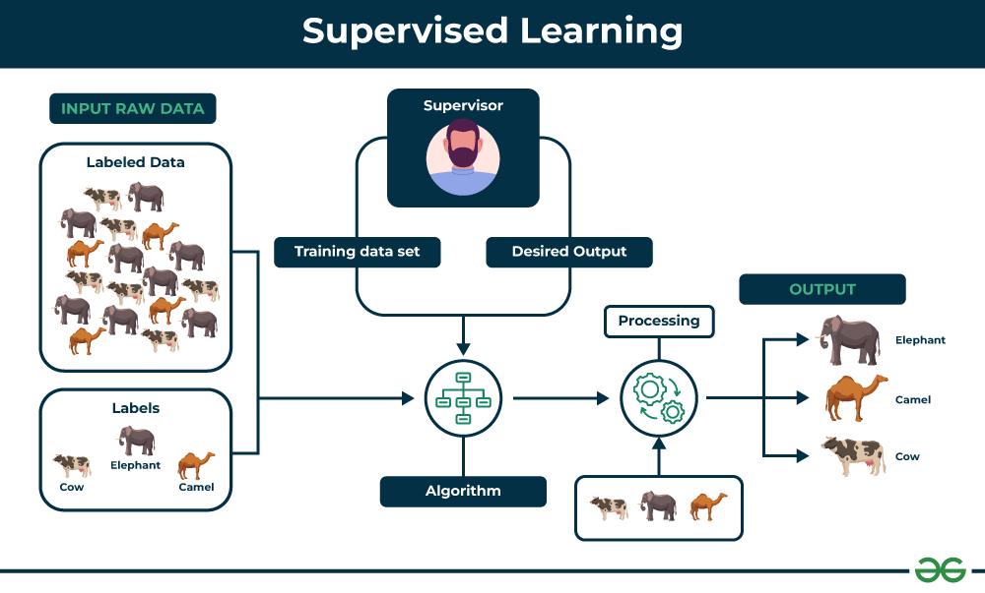
Supervised Learning
Supervised learning involves training a machine from labeled data.
Labeled data consists of examples with the correct answer or classification.
The machine learns the relationship between inputs (fruit images) and outputs (fruit labels).
The trained machine can then make predictions on new, unlabeled data.
Regression: A regression problem is when the output variable is a real value, such as “dollars” or “weight”.
Classification: A classification problem is when the output variable is a category, such as “Red” or “blue” , “disease” or “no disease”.

Slide 26
Types of Supervised
Regression
Classification
Used to predict continuous values, such as house prices, stock prices, or customer churn.
Regression algorithms learn a function that maps from the input features to the output value.
Linear Regression
Polynomial Regression
Support Vector Machine Regression
Decision Tree Regression
Random Forest Regression
Used to predict categorical values, such as whether a customer will churn or not, whether an email is spam or not, or whether a medical image shows a tumor or not.
Classification algorithms learn a function that maps from the input features to a probability distribution over the output classes.
Logistic Regression
Support Vector Machines
Decision Trees
Random Forests
Naive Baye

Slide 27
Evaluating Supervised Learning Models
Regression
Classification
Mean Squared Error (MSE): MSE measures the average squared difference between the predicted values and the actual values. Lower MSE values indicate better model performance.
Root Mean Squared Error (RMSE): RMSE is the square root of MSE, representing the standard deviation of the prediction errors. Similar to MSE, lower RMSE values indicate better model performance.
Mean Absolute Error (MAE): MAE measures the average absolute difference between predicted and actual values. It is less sensitive to outliers compared to MSE or RMSE.
R-squared (Coefficient of Determination): R-squared measures the proportion of the variance in the target variable that is explained by the model. Higher R-squared values indicate better model fit.
Accuracy:
Precision: Precision is the percentage of positive predictions that the model makes that are correct. It is calculated by dividing the number of true positives by the total number of positive predictions.
Recall: Recall is the percentage of all positive examples that the model correctly identifies. It is calculated by dividing the number of true positives by the total number of positive examples.
F1 score: The F1 score is a weighted average of precision and recall. It is calculated by taking the harmonic mean of precision and recall.
Confusion matrix: A confusion matrix is a table that shows the number of predictions for each class, along with the actual class labels. It can be used to visualize the model’s performance and identify areas where the model is struggling.

Slide 28
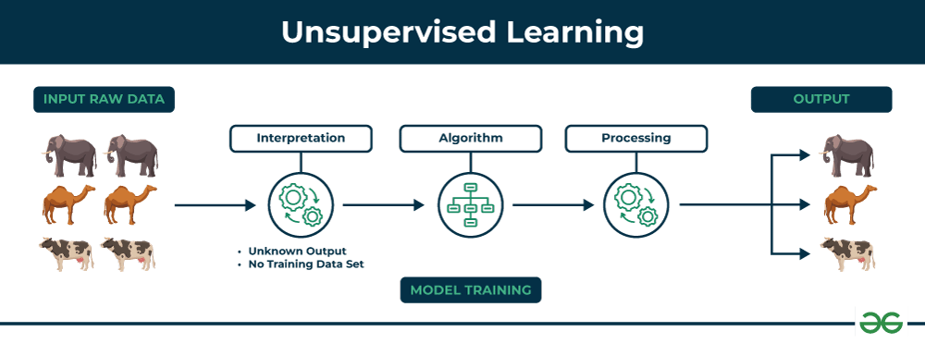
Unsupervised Learning
Unsupervised learning allows the model to discover patterns and relationships in unlabeled data.
Clustering algorithms group similar data points based on their inherent characteristics.
Feature extraction captures essential information from the data, enabling the model to make meaningful distinctions.
Label association assigns categories to the clusters based on the extracted patterns and characteristics.

Slide 29
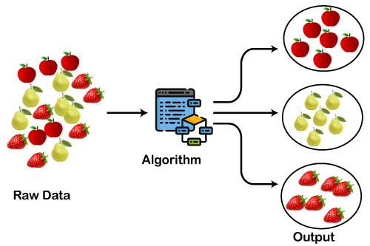
Clustering
A way of grouping the data points into different clusters, consisting of similar data points. The objects with the possible similarities remain in a group that has less or no similarities with another group.
Note: Clustering is somewhere similar to the classification algorithm, but the difference is the type of dataset that we are using. In classification, we work with the labeled data set, whereas in clustering, we work with the unlabeled dataset.
Market Segmentation, Statistical data analysis, Social network analysis, Image segmentation, Anomaly detection, etc.

Slide 30
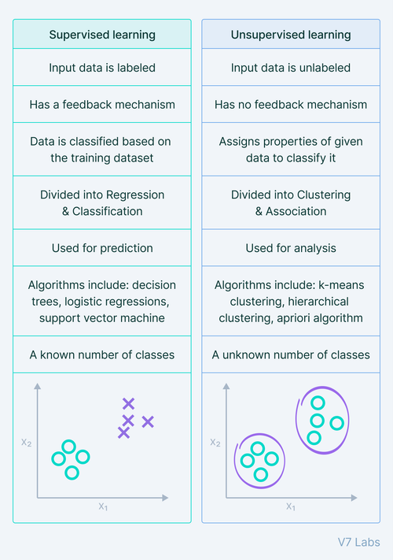

Slide 31
Confusion Matrix

Slide 32
Confusion Matrix
Performance Measurement tool used for evaluating the accuracy of a classification model.
It helps visualize the performance of an algorithm by showing the actual versus predicted classifications in a tabular format.
It offers a thorough analysis of true positive, true negative, false positive, and false negative predictions, facilitating a more profound comprehension of a model’s recall, accuracy, precision, and overall effectiveness in class distinction.
When there is an uneven class distribution in a dataset, this matrix is especially helpful in evaluating a model’s performance beyond basic accuracy metrics.

Slide 33
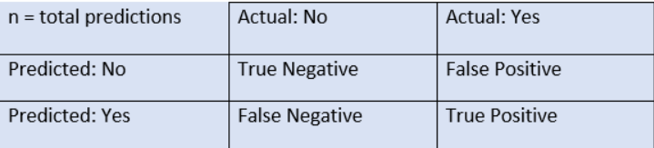
Confusion Matrix for Binary Classification
True Negative: The model has given prediction No, and the real or actual value was also No.
True Positive: The model has predicted yes, and the actual value was also true.
False Negative: The model has predicted no, but the actual value was Yes, it is also called Type-II error.
False Positive: The model has predicted Yes, but the actual value was No. It is also called a Type-I error.

Slide 34
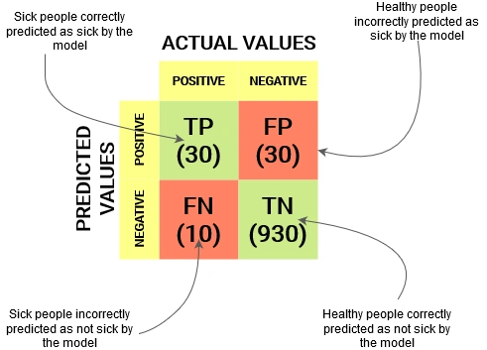
Need for Confusion Matrix
It evaluates the performance of the classification models, when they make predictions on test data, and tells how good our classification model is.
It not only tells the error made by the classifiers but also the type of errors such as it is either type-I or type-II error.
With the help of the confusion matrix, we can calculate the different parameters for the model, such as accuracy, precision, etc.

Slide 35
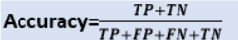
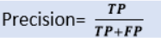
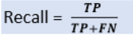
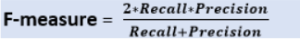
Calculations using Confusion Matrix

Slide 36
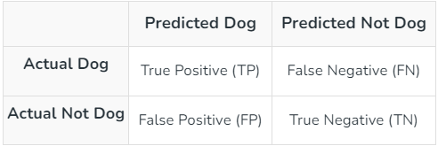
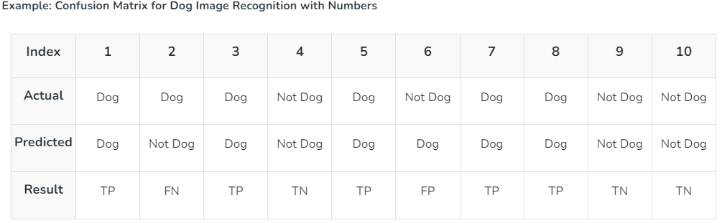
Confusion Matrix- Example

Slide 37
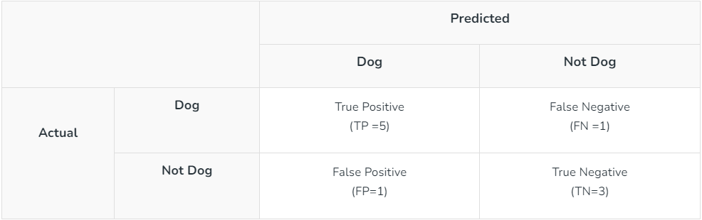
Confusion Matrix- Example
Actual Dog Counts = 6
Actual Not Dog Counts = 4
True Positive Counts = 5
False Positive Counts = 1
True Negative Counts = 3
False Negative Counts = 1

Slide 38

Data Preprocessing

Slide 39
Imputation
Replacing missing values in datasets with substituted values.
Essential for handling incomplete data for algorithms that require complete datasets.
Enables consistent data analysis.
Prevent bias that occurs with listwise deletion of missing data
Improves model performance by providing complete training datasets

Slide 40
Common Imputation Techniques
Mean Imputation:
Missing values are replaced with the mean, median, or mode of the available values in the dataset.
Simple and fast; use statistical central tendency.
Often used as a preliminary approach to quickly handle missing values in a dataset.
Best for symmetrically distributed numerical data with no extreme values or outliers.
Calculate the arithmetic average of observed values and replace all missing values with this mean.
Pros: Maintains the sample mean of the data
Cons: Can reduce the variability of the dataset, potentially leading to underestimated variances and covariances.

Slide 41
Common Imputation Techniques
2. Median Imputation:
Usage: Preferred for skewed numerical data or when data contains outliers.
Process: Replace missing values with the median (the middle value in sorted order) of available observations.
Pros: More robust than mean imputation as it is less affected by outliers or skewed data.
Cons: Like mean imputation, it can affect the distribution of the data, particularly its spread and variance.
3. Mode Imputation:
Usage: Most suitable for categorical data or discrete numerical data.
Process: Identify the most frequently occurring value in the dataset and use this mode value to fill in missing entries.
Pros: Ensure that the imputed values are realistic for categorical data.
Cons: May introduce bias if the mode is not representative of the variability in the data.

Slide 42
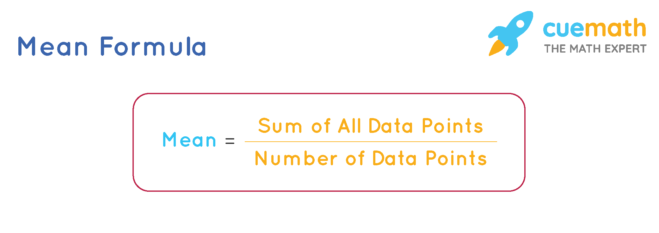
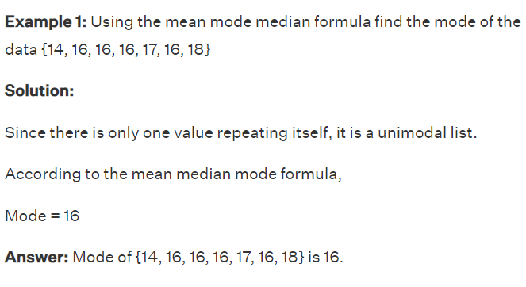
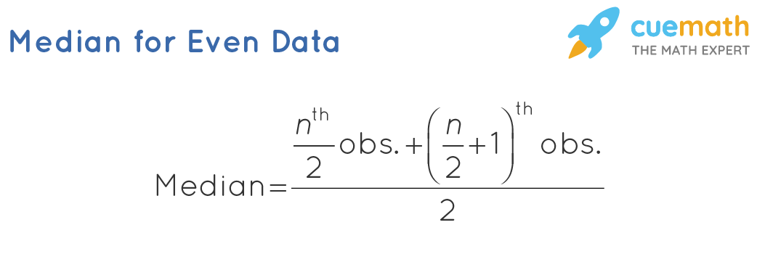
Formulas

Slide 43
Random Imputation
Random Imputation involves replacing missing values with a randomly selected observed value from the same variable.
It maintains the existing distribution of data, assuming values are missing completely at random (MCAR).
Process
Identify the missing entries in a dataset.
For each missing entry, randomly select a value from the set of observed values of that specific variable.
Repeat the process for all missing entries, which can be done with or without replacement.

Slide 44
Random Imputation
Advantages
Preserves Variability: Unlike mean/median/mode imputation, random imputation preserves the original distribution and variability of the data.
Simplicity: Easy to implement and requires minimal computation.
Flexibility: Can be used for both numerical and categorical data.
Limitations
Randomness: The stochastic nature of the method can lead to variability in the imputation results, affecting model stability and reproducibility.
Bias: If the missingness is not completely random (MCAR), random imputation can introduce bias.
Inaccuracy: May not be suitable for data where the relationship between variables is crucial, as it doesn't utilize any correlational structure in the data.

Slide 45
Random Imputation
When to Use
Effective when the dataset is large enough to ensure that the random values are representative of the distribution.
Useful as a benchmark or for initial data analysis, especially to compare against more sophisticated imputation methods.
Appropriate in scenarios where data is missing completely at random and maintaining the data's variance is important.
Challenges
Ensuring consistency across multiple imputations can be difficult due to the random selection process.
Requires careful analysis to confirm that the missingness mechanism is indeed MCAR to avoid introducing systematic errors.

Slide 46
K-Nearest Neighbours (KNN) Imputation
A method to fill in missing data by using the values from the nearest data points.
Neighbors are found based on similarity, measured by how close data points are to each other.
How Does it Work?
Identify data points with missing values.
For each missing value, find the closest 'k' data points (neighbors) that have that value.
Replace the missing value with the average (for numbers) or most common value (for categories) from these neighbors.

Slide 47
K-Nearest Neighbours (KNN) Imputation
Benefits
Limitations
Accuracy: More accurate than just using the average because it considers how data points are related.
Versatility: Works with different types of data, like numbers or categories.
Detail-Oriented: Keeps important patterns in the data that simpler methods might miss.
Speed: Can be slow if the dataset is large because it looks for neighbors for each missing value.
Complexity: May not work well if the data has too many dimensions (features).
Sensitive: The results can change a lot based on which neighbors are closest and can be thrown off by unusual data points (outliers).

Slide 48
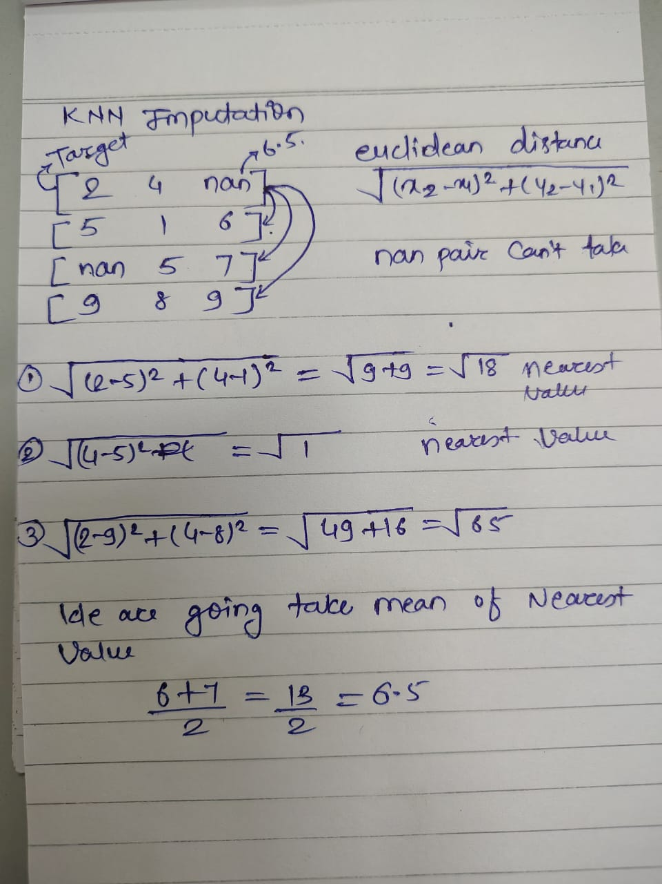

Slide 49
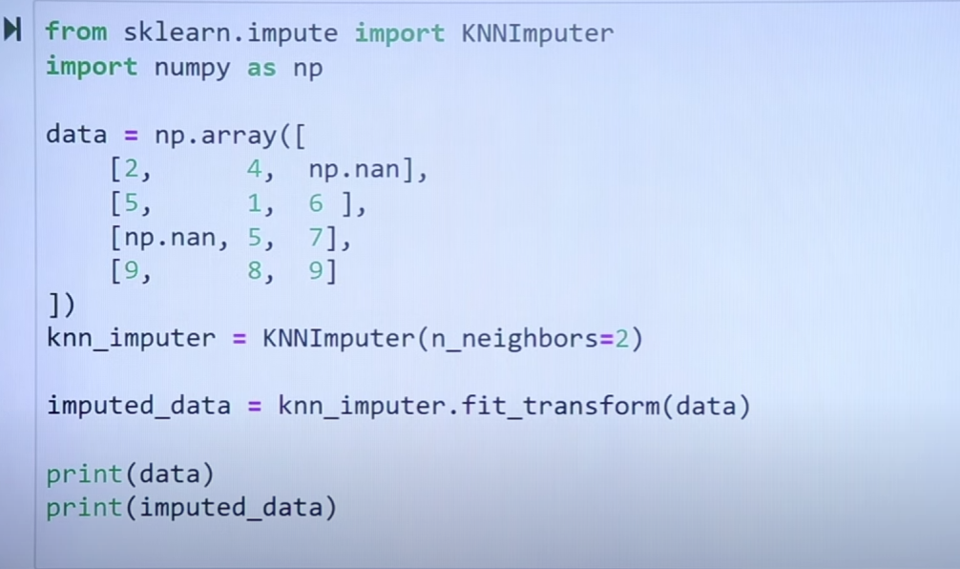

Slide 50
Hot Deck Imputation
A method for filling in missing data by copying values from similar data points within the same dataset.
"Hot deck" means the data used for imputation is drawn from the same dataset being treated, ensuring it's current and relevant.
How Does it Work?
Identify records in the dataset that have missing values.
For each missing entry, find a "donor" record that is similar but has complete data.
Copy the value from the donor to the record with the missing value.

Slide 51
Hot Deck Imputer
Benefits
Relevance: Values are filled in with data from similar cases, keeping the imputed values relevant and consistent.
Flexibility: Can be tailored to use different criteria for defining "similar" records, such as geographic proximity or similar characteristics.
Ease of Use: Simpler than some statistical methods and does not require complex calculations.
Limitations
Bias: Risk of bias if "similar" records aren't well-matched or if donor records are not representative.
Randomness: Depending on the method of selecting donor records, the imputation process can be somewhat random.
Data Quality: Relies on having enough similar and accurate donor records in the dataset, which might not always be available.

Slide 52

Outlier Management

Slide 53
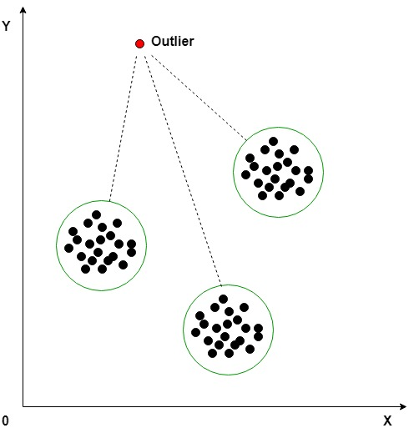
Outlier
Outliers are unusual data points that differ significantly from others:
Causes: Errors in measurement, data entry, or genuine rare events.
Impact:
Statistical Influence: Can skew machine learning training, affecting accuracy and efficiency.
Model Performance: Some models, like linear regression, are very sensitive to outliers, impacting predictions.

Slide 54
Managing Outliers
Removal: Removing outliers might be appropriate if they are due to errors or if their exclusion will not lead to bias in the model’s performance.
Transformation: Applying a mathematical transformation (log, square root, etc.) can reduce the effect of extreme values.
Capping: Outliers can be capped at a certain value determined by a percentile-based approach or other statistical rules.
Imputation: Replace outliers with more central values such as the mean, median, or mode, or use model-based methods if the data points are suspected to be erroneous.

Slide 55
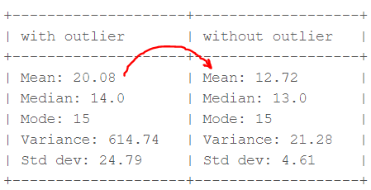
Outlier
Consider a small dataset, sample= [15, 101, 18, 7, 13, 16, 11, 21, 5, 15, 10, 9]. By looking at it, one can quickly say ‘101’ is an outlier that is much larger than the other values.

Slide 56
Outlier Detection Technique
Box Plot
Z score
Inter Quantile Range

Slide 57
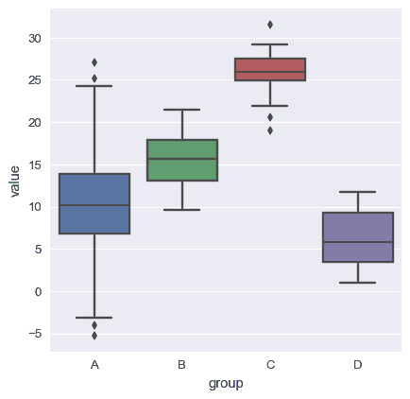
Boxplot

Slide 58
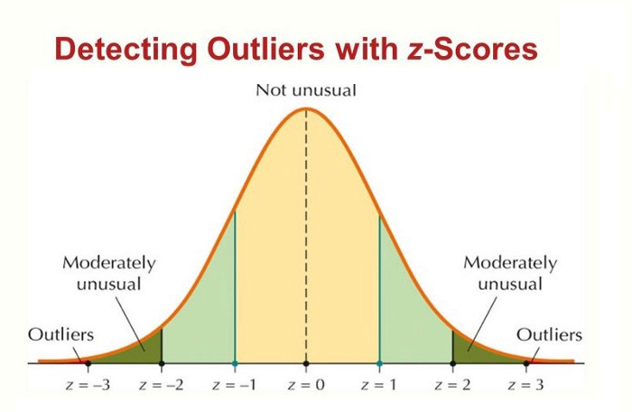
Z-score
Criteria: any data point whose Z-score falls out of 3rd standard deviation is an outlier treatment.
loop through all the data points and compute the Z-score using the formula (Xi-mean)/std.
define a threshold value of 3 and mark the datapoints whose absolute value of Z-score is greater than the threshold as outliers.

Slide 59
Z-Score
Interpreting the Z-score:
A Z-score of 0 means the data point is exactly at the mean.
A positive Z-score indicates the data point is above the mean, while a negative Z-score indicates it is below the mean.
The magnitude of the Z-score shows how far (in terms of standard deviations) the data point is from the mean.
Outlier Detection:
Typically, a Z-score threshold is set to identify outliers. Common thresholds are:
Z > 3 or Z < -3: A data point with a Z-score greater than 3 or less than -3 is considered an outlier in most cases (3 standard deviations away from the mean).
In some cases, a more strict threshold (e.g., Z > 2.5) can be used depending on the sensitivity required.

Slide 60
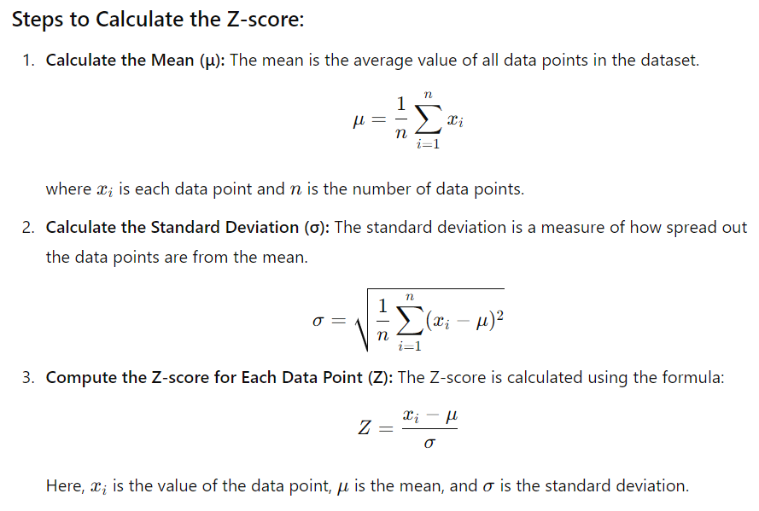

Slide 61
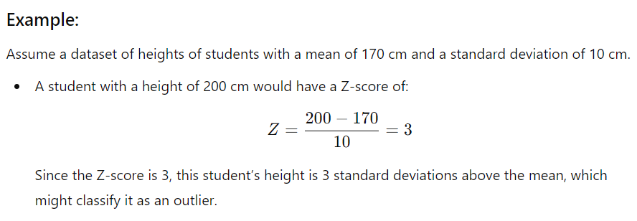
Example

Slide 62
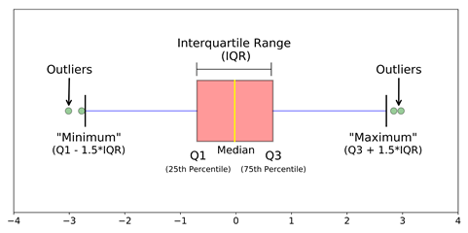
IQR
Criteria: data points that lie 1.5 times of IQR above Q3 and below Q1 are outliers. This shows in detail about outlier treatment in Python.
Steps
calculate the Sort the dataset in ascending order
1st and 3rd quartiles(Q1, Q3)
compute IQR=Q3-Q1
compute lower bound = (Q1–1.5*IQR), upper bound = (Q3+1.5*IQR)
loop through the values of the dataset and check for those who fall below the lower bound and above the upper bound and mark them as outlier treatment in python

Slide 63
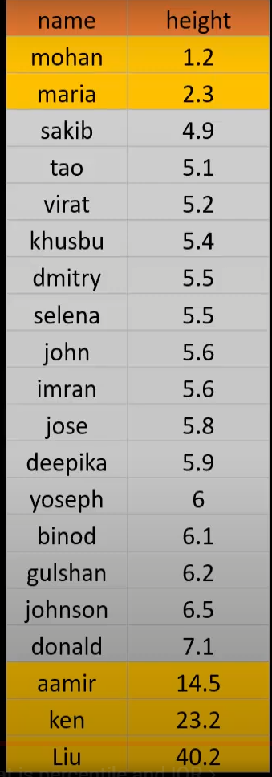
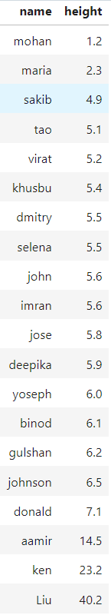
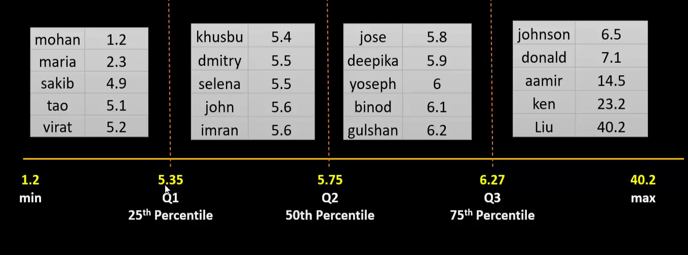
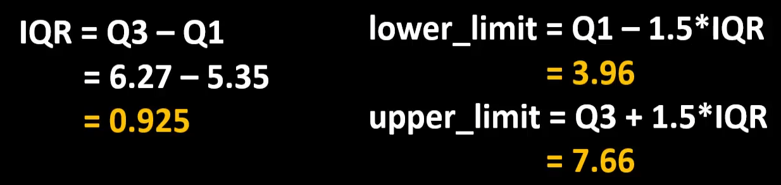
IQR
Upper Limit: 3.69
Lower Limit: 7.66
Total Samples: 20

Slide 64
One Hot Encoding
One hot encoding is a technique that we use to represent categorical variables as numerical values in a machine learning model.
It creates binary columns (0s & 1s) for each unique category pf the categorical variable
How It Works:
For each category in a categorical variable, a new binary column is created.
A '1' is placed in the column corresponding to the category and '0's in all other columns for that variable.
When to Use:
One-hot encoding is suitable for algorithms that cannot handle categorical variables directly, such as linear regression, SVM, and KNN.
It works well with tree-based algorithms (like decision trees, random forests, or gradient boosting), but these algorithms can sometimes handle categorical variables in other ways.

Slide 65
One Hot Encoding
Advantages
It allows the use of categorical variables in models that require numerical input.
It can improve model performance by providing more information to the model about the categorical variable.
It can help to avoid the problem of ordinality, which can occur when a categorical variable has a natural ordering (e.g. “small”, “medium”, “large”).
Disadvantages
It can lead to increased dimensionality, as a separate column is created for each category in the variable. This can make the model more complex and slow to train.
It can lead to sparse data, as most observations will have a value of 0 in most of the one-hot encoded columns.
It can lead to overfitting, especially if there are many categories in the variable and the sample size is relatively small.
One-hot-encoding is a powerful technique to treat categorical data, but it can lead to increased dimensionality, sparsity, and overfitting.

Slide 66
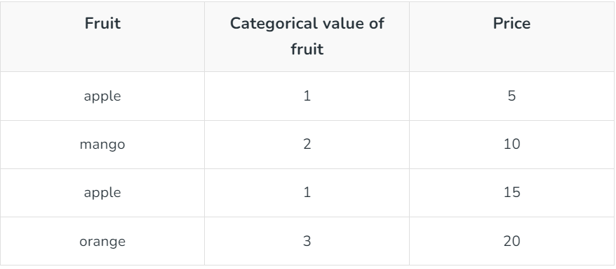
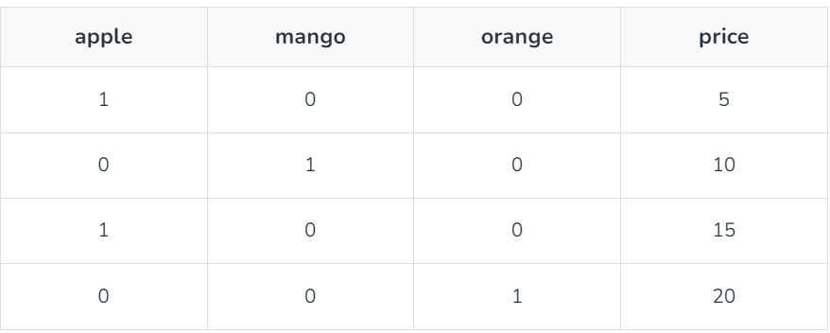
Example

Slide 67
Dimensionality Reduction
It is a key preprocessing step in machine learning and data analysis that focuses on reducing the number of features in a dataset while retaining as much information as possible.
The greater the number of features of a machine learning model, the lower its performance.
complex high-dimensional data often leads to overfitting.
The dimensionality reduction provides the solution to this problem by reducing the complexity of the model and improving its generalization performance.

Slide 68
Dimensionality Reduction
Benefits:
Reduces Overfitting: By simplifying the model and removing noise, the model generalizes better to new, unseen data.
Improves Model Performance: With fewer features, training times are reduced, and the model becomes less complex.
Mitigates the Curse of Dimensionality: In high-dimensional spaces, data points become sparse, and distance measures become less meaningful, affecting the model’s performance. Dimensionality reduction addresses this problem.
Easier Visualization: It helps visualize high-dimensional data in 2D or 3D, which aids in gaining insights from the data
Disadvantages:
Loss of Information
Hard to interpret
Can reduce model accuracy
May not work for complex data
Computationally Expensive
Deciding how many features to keep
Results vary across the dataset

Slide 69
Dimensionality Reduction- Features Extraction
Feature extraction involves the creation of new features by combining or transforming the original features.
The main purpose of this method is to create a feature set that captures the essence of the original data in a lower dimensional space.
These new features capture the important information from the original features but in a simpler, reduced form.
By simplifying the model with fewer features, feature extraction helps avoid overfitting, where the model performs well on training data but poorly on new data.
feature extraction tries to keep the most important information from the original data.

Slide 70
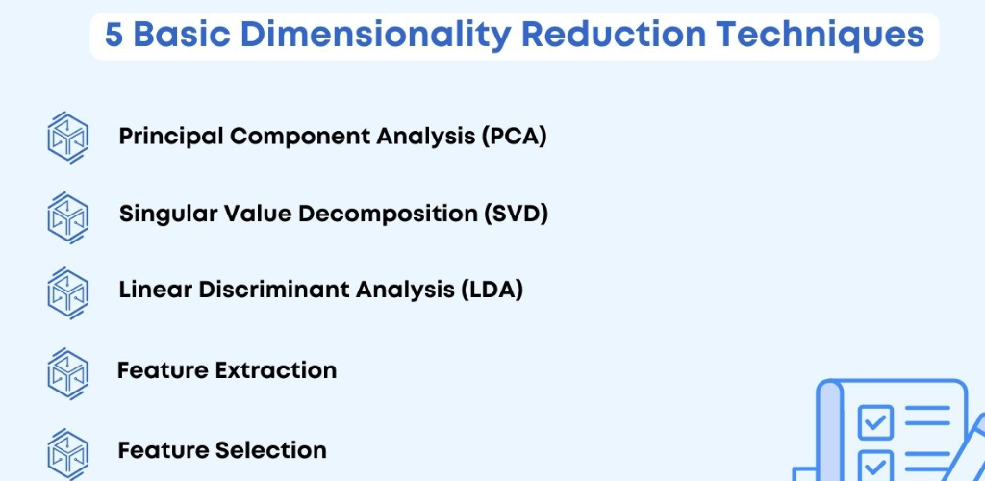

Slide 71
Linear Regression
Simple to implement & efficient to train.
Overfitting can be reduced using regularization
Performs well when the dataset linearly separable
Assumes that the data is independent which is rare in real life
Prone to noise & overfitting
Sensitive to outliers

Slide 72
Types of Linear Regression
1. Simple Linear Regression
2. Multiple Linear Regression

Slide 73
Simple Linear Regression
Involves only one independent variable and one dependent variable.
y=C​+m​X where:
Y is the dependent variable
X is the independent variable
C is the intercept
m is the slope

Slide 74
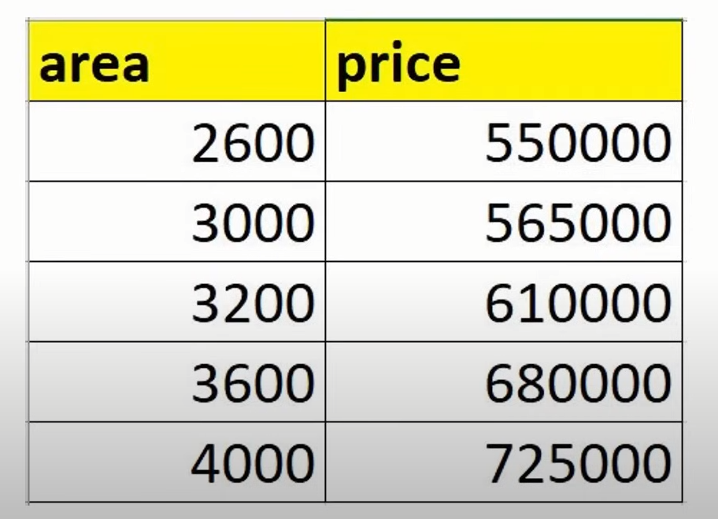
Simple Linear Regression

Slide 75
Applications of Simple Linear Regression
Estimating an employee's salary based on their years of experience.
Predicting the number of defective items in a manufacturing process based on a single predictor like machine operating hours.
Estimating calorie burn based on the duration of exercise
Predicting students' test scores based on the number of study hours.

Slide 76
Multiple Linear Regression
Involves more than one independent variable and one dependent variable.
y=β0​+β1​X+β2​X+………βn​X where:
Y is the dependent variable
X1, X2, …, Xp are the independent variables
β0 is the intercept
β1, β2, …, βn are the slopes

Slide 77
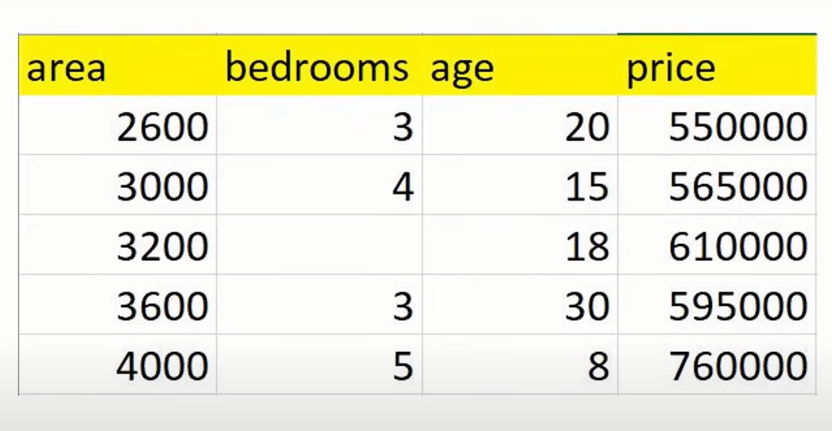
Multiple Linear Regression

Slide 78
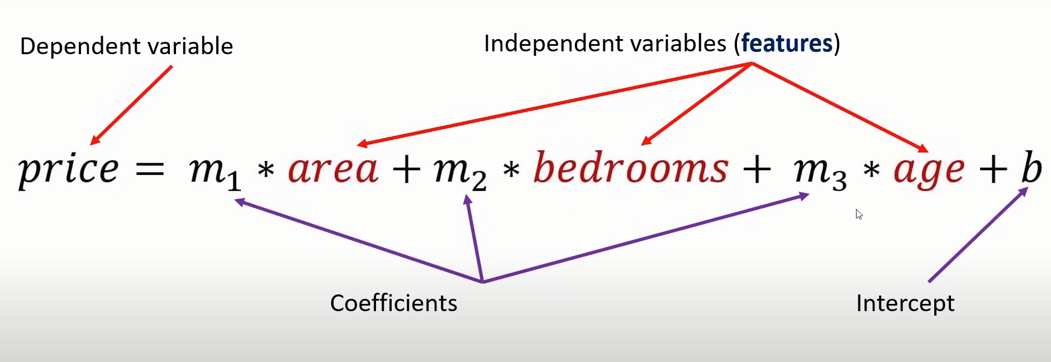

Slide 79
Applications of Multiple Linear Regression
Estimating the price of a house based on multiple features such as size, number of bedrooms, location, and age of the property.
Predicting patient outcomes based on multiple variables like age, weight, blood pressure, and cholesterol levels.
Analyzing customer satisfaction scores based on multiple predictors like service quality, product quality, and price.
Predicting traffic flow based on multiple variables like time of day, weather conditions, and roadwork status.

Slide 80
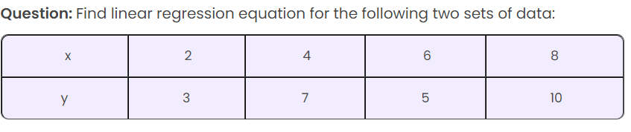
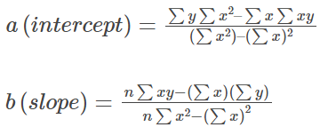
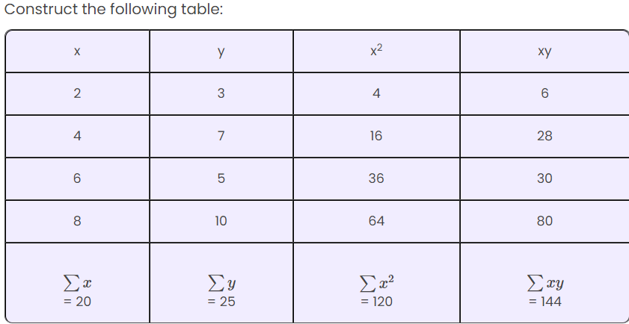
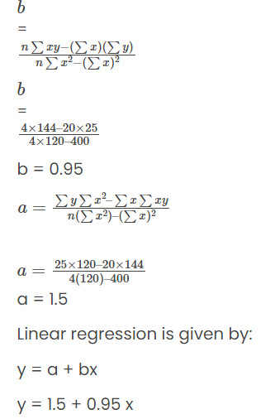

Slide 81




Examples

Slide 82


Logistic Regression
Supervised Learning Algorithm
Logistic regression predicts the output of a categorical dependent variable. Therefore, the outcome must be a categorical or discrete value.
It can be either Yes or No, 0 or 1, true or False, etc. but instead of giving the exact value as 0 and 1, it gives the probabilistic values which lie between 0 and 1.
In Logistic regression, instead of fitting a regression line, we fit an “S” shaped logistic function, which predicts two maximum values (0 or 1).

Slide 83
Logistic Regression – Sigmoid Function
The sigmoid function is a mathematical function used to map the predicted values to probabilities.
It maps any real value into another value within a range of 0 and 1. The value of the logistic regression must be between 0 and 1, which cannot go beyond this limit, so it forms a curve like the “S” form.
The S-form curve is called the Sigmoid function or the logistic function.
In logistic regression, we use the concept of the threshold value, which defines the probability of either 0 or 1. Such as values above the threshold value tend to 1, and a value below the threshold values tends to 0.

Slide 84
Assumptions of Logistic Regression
Independent observations: Each observation is independent of the other. meaning there is no correlation between any input variables.
Binary dependent variables: It takes the assumption that the dependent variable must be binary or dichotomous, meaning it can take only two values. For more than two categories SoftMax functions are used.
Linearity relationship between independent variables and log odds: The relationship between the independent variables and the log odds of the dependent variable should be linear.
No outliers: There should be no outliers in the dataset.
Large sample size: The sample size is sufficiently large

Slide 85
Types of Logistic Regression
Binomial: In binomial Logistic regression, there can be only two possible types of dependent variables, such as 0 or 1, Pass or Fail, etc.
Multinomial: In multinomial Logistic regression, there can be 3 or more possible unordered types of the dependent variable, such as “cat”, “dogs”, or “sheep”
Ordinal: In ordinal Logistic regression, there can be 3 or more possible ordered types of dependent variables, such as “low”, “Medium”, or “High”.

Slide 86


Slide 87



Logistic Regression - Example

Slide 88



Slide 89

Polynomial Regression
It is a regression algorithm models the relationship between a dependent(y) and independent variable(x) as nth degree polynomial. The Polynomial Regression equation is given below:
Where,
y is the predicted output (dependent variable).
x1​ is the input feature (independent variable).
b0​,b1​,b2​,..., bn​ are the coefficients or parameters of the model.
x12​,x13​,...,x1n​ are the polynomial terms or powers of the original feature

Slide 90
Polynomial Regression
Polynomial Regression as a Special Case: It is considered a special case of Multiple Linear Regression in machine learning.
Conversion by Adding Polynomial Terms: Polynomial terms are added to the Multiple Linear Regression equation to transform it into Polynomial Regression.
Linear Model with Modifications: It remains a linear model but includes modifications to enhance accuracy.
Handling Non-Linear Data: Polynomial Regression is used when the training dataset exhibits non-linear characteristics.
Fitting Complex Functions: It employs a linear regression model to fit complex and non-linear functions and datasets.
Feature Transformation: Original features are converted into polynomial features of the required degree (2, 3, ..., n) and then modeled using a linear approach.

Slide 91

Polynomial Regression
Linear Models on Non-Linear Data: Applying a linear model on non-linear data results in poor performance, higher error, and lower accuracy due to improper fitting.
Need for Polynomial Regression: Polynomial Regression is required when data points are arranged non-linearly, as it captures complex patterns better than linear models.
Comparison: A linear model struggles to fit non-linear data, while a polynomial curve can cover most data points effectively.

Slide 92
K-Nearest Neighbour
K-Nearest Neighbour is one of the simplest Machine Learning algorithms based on Supervised Learning technique.
K-NN algorithm assumes the similarity between the new case/data and available cases and put the new case into the category that is most similar to the available categories.
K-NN algorithm stores all the available data and classifies a new data point based on the similarity. This means when new data appears then it can be easily classified into a well suite category by using K- NN algorithm.
K-NN algorithm can be used for Regression as well as for Classification but mostly it is used for the Classification problems.
K-NN is a non-parametric algorithm, which means it does not make any assumption on underlying data.
It is also called a lazy learner algorithm because it does not learn from the training set immediately instead it stores the dataset and at the time of classification, it performs an action on the dataset.
KNN algorithm at the training phase just stores the dataset and when it gets new data, then it classifies that data into a category that is much similar to the new data.

Slide 93




Slide 94
How does K-NN work?
Step 1: Select the number K of the neighbors
Step 2: Calculate the Euclidean distance of K number of neighbors
Step 3: Take the K nearest neighbors as per the calculated Euclidean distance.
Step 4: Among these k neighbors, count the number of the data points in each category.
Step 5: Assign the new data points to that category for which the number of the neighbor is maximum.
Step 6: Our model is ready.

Slide 95
Advantages of KNN Algorithm:
It is simple to implement.
It is robust to the noisy training data
It can be more effective if the training data is large.
Disadvantages of KNN Algorithm:
Always needs to determine the value of K which may be complex some time.
The computation cost is high because of calculating the distance between the data points for all the training samples.

Slide 96

Larger K value: The case of underfitting occurs when the value of k is increased. In this case, the model would be unable to correctly learn on the training data.
Smaller k value: The condition of overfitting occurs when the value of k is smaller. The model will capture all of the training data, including noise. The model will perform poorly for the test data in this scenario.

Slide 97
KNN in Regression
Purpose: Predicts a continuous value based on the average of the target values of its nearest neighbors.
Distance Metric: Typically uses Euclidean distance to find the nearest neighbors.
Prediction: The predicted value is the mean (or weighted average) of the values of the k nearest neighbors.
Sensitivity to k: Small values of k can lead to high variance, while large values can result in high bias.
Outlier Sensitivity: KNN regression can be sensitive to outliers as they may skew the average.
Non-parametric: No assumptions about the underlying data distribution.
Scaling: Input features should be scaled, as KNN is distance-based and sensitive to feature magnitudes.
KNN in Classification
Purpose: Classifies a data point based on the majority class of its nearest neighbors.
Distance Metric: Most commonly uses Euclidean distance, but can also use other distance metrics (e.g., Manhattan, Minkowski).
Prediction: The predicted class is determined by the majority vote among the k nearest neighbors.
Sensitivity to k: Small values of k can lead to overfitting, while large values may lead to underfitting.
Decision Boundaries: KNN creates non-linear decision boundaries depending on the distribution of the data.
Outlier Handling: More robust to outliers compared to KNN regression due to majority voting.
Non-parametric: No need for assumptions about the distribution of data.
Feature Scaling: Distance-based, so features need to be normalized or standardized for accurate predictions.

Slide 98


Example
Now predict the genre of “Barbie” movie with the IMDB rating 7.4 & duration 114 minutes where K=3

Slide 99
Decision Tree
Decision Tree is a supervised learning technique for classification and regression, mainly used for classification.
It is a tree-structured classifier with internal nodes representing features, branches representing decision rules, and leaf nodes representing outcomes.
Decision nodes make decisions with multiple branches, while leaf nodes represent final outcomes with no branches.
Decisions are based on the features of the dataset.
It visually represents possible solutions to a decision problem.
Called a "decision tree" because it starts from a root node and expands into a tree-like structure.
Built using the CART (Classification and Regression Tree) algorithm.
Splits the tree into subtrees based on Yes/No answers to questions.
A decision tree can contain categorical data (YES/NO) as well as numeric data.

Slide 100

Root Node: The highest node, representing the initial feature or decision.
Internal Nodes (Decision Nodes): Nodes where decisions are made based on attribute values, leading to further branches.
Leaf Nodes (Terminal Nodes): End nodes where predictions or decisions are made, with no further branches.
Branches (Edges): Connections between nodes representing decision paths.
Splitting: Dividing a node into sub-nodes based on a chosen feature and threshold.
Parent Node: A node that splits into child nodes.
Child Node: Nodes formed from a parent node's split.
Decision Criterion: The rule used to split data at a decision node.
Pruning: Removing branches to prevent overfitting and improve generalization.

Slide 101



Slide 102
Information Gain

Slide 103

Gini Index

Slide 104
Advantages of the Decision Tree
It is simple to understand as it follows the same process which a human follow while making any decision in real-life.
It can be very useful for solving decision-related problems.
It helps to think about all the possible outcomes for a problem.
There is less requirement of data cleaning compared to other algorithms.
Disadvantages of the Decision Tree
The decision tree contains lots of layers, which makes it complex.
It may have an overfitting issue, which can be resolved using the Random Forest algorithm.
For more class labels, the computational complexity of the decision tree may increase.
Solved Problems: https://drive.google.com/drive/folders/1UZWXxYx5bOx4io9scYt2UpyYEGntRKcH?usp=sharing

Slide 105


Slide 106



Slide 107



Slide 108


Gain(Ssunny, Temp)=0.57
Gain(Ssunny, Humidity)=0.97
Gain(Ssunny, Wind)=0.019

Slide 109
Scenario Based Question
You are a data scientist at a retail company, and you are tasked with predicting whether a customer will buy a product based on their browsing behavior. The dataset contains features like:
Time spent on the website
Number of pages visited
Whether the customer added items to the cart (Yes/No)
Previous purchase history (Yes/No)
You decide to use a decision tree classifier to make this prediction.
Question:
How would a decision tree help in predicting whether a customer will make a purchase or not based on this dataset?
Explain how the decision tree would split the data and use the features to classify customers into "Buy" or "Not Buy" categories.
What criteria would the decision tree use to decide which feature to split on at each node?
Answer:
A decision tree would help by splitting the data based on the features like time spent on the website, number of pages visited, items added to the cart, and previous purchase history. At each decision node, it would choose the feature that best separates the data into "Buy" or "Not Buy" categories, using criteria like Gini Index or Information Gain. For example, it might first split on whether the customer added items to the cart (Yes/No), then further split on time spent or previous purchase history to refine the prediction. Each leaf node would then represent a final prediction of "Buy" or "Not Buy."

Slide 110


Python code

Slide 111
Random Forest Algorithm
The greater number of trees in the forest leads to higher accuracy and prevents the problem of overfitting.
It takes less training time as compared to other algorithms.
It predicts output with high accuracy, even for the large dataset it runs efficiently.
It can also maintain accuracy when a large proportion of data is missing.
There should be some actual values in the feature variable of the dataset so that the classifier can predict accurate results rather than a guessed result.
The predictions from each tree must have very low correlations.

Slide 112


Random Forest Algorithm

Slide 113
Random Forest – Working

Slide 114

Random Forest for Regression

Slide 115

Random Forest Example

Slide 116
Applications of Random Forest

Slide 117
Advantages & Disadvantages
Advantages
Disadvantages
Random Forest is capable of performing both Classification and Regression tasks.
It is capable of handling large datasets with high dimensionality.
It enhances the accuracy of the model and prevents the overfitting issue.
Although random forest can be used for both classification and regression tasks, it is not more suitable for Regression tasks.

Slide 118

Decision Tree VS Random Forest

Slide 119
Naïve Bayes Classifier
Solved Problems: https://drive.google.com/drive/folders/1HFksukQlH8kG7jxMkyxTqH6EmUe2FIX_?usp=sharing

Slide 120

Shopping Example

Slide 121

Bayes Theorem

Slide 122
Assumptions of Naïve Bayes

Slide 123

Working of Algorithm
Create a Likelihood table by finding the probabilities

Slide 124
Applications of naïve bayes

Slide 125
Types of Naïve Bayes

Slide 126
1. Gaussian Naive Bayes
When to Use: When your feature variables are continuous and assumed to follow a normal (Gaussian) distribution.
How It Works: It calculates the mean and variance of each feature for each class and uses these parameters to compute the probability of a feature value given a class.
Example: Predicting whether a flower is a certain species based on continuous measurements like petal length and width.
2. Multinomial Naive Bayes
When to Use: Best for discrete count data, often used in text classification where features represent word counts or frequencies.
How It Works: It models the distribution of features as multinomial distributions, making it suitable for features that are counts or frequencies.
Example: Spam detection in emails by counting the frequency of specific words.

Slide 127
3. Bernoulli Naive Bayes
When to Use: Suitable for binary/boolean features, where features are present or absent.
How It Works: It assumes that each feature is a binary indicator (0 or 1) and models the presence or absence of a feature for each class.
Example: Document classification based on the presence or absence of specific words, regardless of how many times they appear.
5. Categorical Naive Bayes
When to Use: When features are categorical (i.e., they take on a limited, fixed number of possible values).
How It Works: It models each feature with a categorical distribution, calculating the probability of each category within each class.
Example: Predicting user preferences based on categorical data like color choices or brand preferences.

Slide 129
Pro’s & Con’s
It is easy and fast to predict the class of test data set. It also performs well in multi-class prediction
When the assumption of independence holds, the classifier performs better than other machine learning models, requiring less training data.
It perform well in case of categorical input variables compared to numerical variable(s). For numerical variable, normal distribution is assumed
Zero Frequency Problem: Feature present in Test data but not available in Training data
Naïve Bayes is also known as a bad estimator, so the probability outputs from predict_proba should not be taken too seriously.

Slide 130



Slide 131




A company wants to predict whether a customer will buy a product (Yes or No) based on two features: Age (Young, Middle-aged, Senior) and Income (Low, Medium, High).

Slide 132



A school wants to predict whether a student will Pass or Fail an exam based on two features: Study Hours (Low, Medium, High) and Sleep Hours (Low, Medium, High).

Slide 133
Scenario Based Question
Questions: You are part of a team building a spam email detector for an email service provider. The goal is to classify emails as "Spam" or "Not Spam" using the Naive Bayes classifier.
a) Explain how the Naive Bayes classifier can be applied to classify emails as spam or not spam. What type of features would you extract from the email data?
b) In this case, what are the challenges associated with applying the Naive Bayes classifier to detect spam? How would you handle these challenges?
c) How can you improve the performance of the Naive Bayes classifier for spam detection if it starts misclassifying certain emails?
Answer:
a) Applying Naive Bayes to Spam Detection:
Text Features: Extract features such as the frequency of specific words, phrases, or symbols commonly found in spam (e.g., "free," "buy now," "win").
Training: Train the model using labeled emails, where each email is labeled as "Spam" or "Not Spam."
Probabilities: The classifier computes the probability of an email being spam based on the occurrence of certain words. For each new email, it calculates the likelihood that the email belongs to each class (spam or not spam) and selects the one with the highest probability.
b) Challenges:
Word Context: Words used in spam emails can also appear in non-spam emails, leading to potential misclassification.
Changing Patterns: Spammers may frequently change their tactics, using new words and structures.
Handling Rare Words: Words that are rare in the training set may not provide strong evidence for classification.
Handling Challenges:
Update Model Regularly: Continuously update the model with recent data to capture new spam patterns.
Smoothing Techniques: Apply Laplace smoothing to handle unseen or rare words.
Feature Selection: Focus on features that strongly distinguish between spam and not spam (e.g., unusual word combinations).
c) Improving Performance:
Use Bi-Grams: Instead of individual words, consider pairs of words (bi-grams) to capture important word sequences (e.g., "win now").
Filter Common Words: Remove common but uninformative words like "and" or "the" using stopword removal.
Regularization: Penalize certain features that might cause overfitting, like specific keywords that are over-represented in training but not indicative in general.

Slide 134
Support Vector Machine
A Support Vector Machine (SVM) is a supervised machine learning algorithm primarily used for classification tasks, but it can also be employed for regression and outlier detection. The core idea behind SVM is to find the optimal boundary (or hyperplane) that best separates data points of different classes in a high-dimensional space.
Hard Margin: A hard margin refers to the maximum-margin hyperplane that perfectly separates the data points of different classes without any misclassifications.
Soft Margin: When data contains outliers or is not perfectly separable, SVM uses the soft margin technique. This method introduces a slack variable for each data point to allow some misclassifications while balancing between maximizing the margin and minimizing violations.

Slide 135

Support Vector Machine

Slide 136


Identify Right Hyper Plane

Slide 137



Non-Linear SVM

Slide 138
Kernels in SVM
the SVM algorithm has a technique called the kernel trick. The SVM kernel transforms low-dimensional input space to a higher dimensional space, making non-separable problems separable, useful for non-linear data separation by applying complex data transformations based on labels.
Linear Kernel
Polynomial Kernel
Radial Basis Function (RBF) Kernel / Gaussian Kernel
Sigmoid Kernel

Slide 139

Apply Kernel on Non-Linear

Slide 140
Types of SVM
Linear SVM: When the data is perfectly linearly separable only then we can use Linear SVM. Perfectly linearly separable means that the data points can be classified into 2 classes by using a single straight line(if 2D).
Non-Linear SVM: When the data is not linearly separable then we can use Non-Linear SVM, which means when the data points cannot be separated into 2 classes by using a straight line (if 2D) then we use some advanced techniques like kernel tricks to classify them. In most real-world applications we do not find linearly separable data points hence we use kernel tricks to solve them.

Slide 141
Advantages
High-Dimensional Performance: SVM excels in high-dimensional spaces, making it suitable for image classification and gene expression analysis.
Nonlinear Capability: Utilizing kernel functions like RBF and polynomial, SVM effectively handles nonlinear relationships.
Outlier Resilience: The soft margin feature allows SVM to ignore outliers, enhancing robustness in spam detection and anomaly detection.
Binary and Multiclass Support: SVM is effective for both binary classification and multiclass classification, suitable for applications in text classification.
Memory Efficiency: SVM focuses on support vectors, making it memory efficient compared to other algorithms.

Slide 142
Disadvantages
Slow Training: SVM can be slow for large datasets, affecting performance in SVM in data mining tasks.
Parameter Tuning Difficulty: Selecting the right kernel and adjusting parameters like C requires careful tuning, impacting SVM algorithms.
Noise Sensitivity: SVM struggles with noisy datasets and overlapping classes, limiting effectiveness in real-world scenarios.
Limited Interpretability: The complexity of the hyperplane in higher dimensions makes SVM less interpretable than other models.
Feature Scaling Sensitivity: Proper feature scaling is essential; otherwise, SVM models may perform poorly.

Slide 143


Python Code

Slide 144
Unsupervised Learning

Slide 145

K-Means Clustering

Slide 146
K-Means Clustering Working
Step 1: Select the number K to decide the number of clusters.
Step 2: Select random K points or centroids. (It can be other than the input dataset).
Step 3: Assign each data point to their closest centroid, which will form the predefined K clusters.
Step 4: Calculate the variance and place a new centroid of each cluster.
Step 5: Repeat the third step, which means reassigning each datapoint to the new closest centroid of each cluster.
Step 6: If any reassignment occurs, then go to step 4 else go to FINISH.
Step 7: The model is ready.

Slide 147


Slide 148


Slide 149


Slide 150




Slide 151
Scenario Based Question
Scenario: A gym wants to offer personalized training programs to its members based on their workout habits. They have collected data on each member’s Weekly Workout Duration (in hours) and Weekly Calories Burned. They want to segment their members into two groups to offer tailored training programs for high and low-activity members.
Question: Explain how K-means clustering can be used to segment the gym members into two groups based on their workout duration and calories burned. Describe the basic steps.
Solution
Data Preparation Collect the data for each member, focusing on Weekly Workout Duration and Weekly Calories Burned. Make sure the data is clean and formatted correctly.
Choose the Number of Clusters (k = 2) Since the gym wants two segments, we set k=2 for the K-means algorithm.
Applying K-means Clustering Run the K-means algorithm:
Step 1: Randomly initialize two centroids.
Step 2: Assign each member to the nearest centroid based on their weekly workout duration and calories burned.
Step 3: Update the centroids by averaging the values within each cluster.
Step 4: Repeat steps 2 and 3 until the centroids stabilize.
Interpreting the Clusters After clustering, members will fall into two groups:
Group 1: Low-activity members.
Group 2: High-activity members.

Slide 152

Hierarchical Clustering
Hierarchical clustering is a type of unsupervised learning algorithm that groups data into a hierarchy of clusters, often visualized as a tree or dendrogram. Unlike K-means clustering, it doesn’t require a predefined number of clusters.
Dendrogram: A tree-like structure showing the hierarchy of clusters; the height represents the distance at which clusters are merged. The number of clusters can be decided by cutting the dendrogram at a specific level.

Slide 153

Agglomerative Clustering
Agglomerative is a bottom-up approach, in which the algorithm starts with taking all data points as single clusters and merging them until one cluster is left.
Step-1: Create each data point as a single cluster. Let's say there are N data points, so the number of clusters will also be N.
Step-2: Take two closest data points or clusters and merge them to form one cluster. So, there will now be N-1 clusters.
Step-3: Again, take the two closest clusters and merge them together to form one cluster. There will be N-2 clusters.
Step-4: Repeat Step 3 until only one cluster left. So, we will get the following clusters.
Step-5: Once all the clusters are combined into one big cluster, develop the dendrogram to divide the clusters as per the problem.

Slide 154







Slide 155

Divisive Clustering
Start with One Cluster
Begin with all data points in a single cluster.
Split into Two Sub-clusters
Divide the cluster into two smaller groups based on dissimilarity (using methods like K-means).
Repeat Splitting
Continue dividing each new cluster until you reach the desired number of clusters or no meaningful splits remain.
Stop When Satisfied
End when clusters are distinct or meet a set condition (e.g., number of clusters).
Visualize with Dendrogram (Optional)
Optionally, use a dendrogram to show the split hierarchy.

Slide 156

Working of Dendrogram in Hierarchical Clustering

Slide 157


Slide 158



Measure the distance between 2 Clusters
Single Linkage: It is the Shortest Distance between the closest points of the clusters.
Complete Linkage: It is the farthest distance between the two points of two different clusters. It is one of the popular linkage methods as it forms tighter clusters than single-linkage.
Centroid Linkage: It is the linkage method in which the distance between the centroid of the clusters is calculated.
Average Linkage: It is the linkage method in which the distance between each pair of datasets is added up and then divided by the total number of datasets to calculate the average distance between two clusters. It is also one of the most popular linkage methods.

Slide 159
Principal Component Analysis
PCA comes under the Unsupervised Machine Learning category
The main goal of PCA is to reduce the number of variables in a data collection while retaining as much information as feasible. Principal component analysis in machine learning can be mainly used for Dimensionality Reduction and important feature selection.
Correlated features to Independent features
When should Principal Component Analysis be used in ML?
- Whenever we need to know our features are independent of each other
- Whenever we need fewer features from higher features

Slide 160

Basic terminologies in PCA
Variance: For calculating the variation of data distributed across the dimensionality of the graph
Covariance: Calculating dependencies and relationship between features
Standardizing data: Scaling our dataset within a specific range for unbiased output

Slide 161


Covariance matrix: Used for calculating interdependencies between the features or variables and helps in reducing it to improve the performance

Slide 162

EigenValues and EigenVectors: The eigenvectors aim to find the largest dataset variance to calculate the Principal Component. Eigenvalue means the magnitude of the Eigenvector. The eigenvalue indicates variance in a particular direction, whereas the eigenvector expands or contracts the X-Y (2D) graph without altering the direction.
In this shear mapping, the blue arrow changes direction, whereas the pink arrow does not. In this instance, the pink arrow is an eigenvector because of its constant orientation. The length of this arrow is also unaltered, and its eigenvalue is 1. Technically, a PC is a straight line that captures the data’s maximum variance (information). PC shows direction and magnitude. PCs are perpendicular to each other.

Slide 163

Dimensionality Reduction: Transpose of original data and multiply it by transposing of the derived feature vector. Reducing the features without losing information.

Slide 164
How Does PCA works?

Slide 165


Slide 166


Slide 167
Curse of Dimensionality

Slide 168



Slide 169



Slide 170



Slide 171
Advantages of PCA in ML
Used for Dimensionality Reduction
PCA will assist you in eliminating all related features, sometimes called multi-collinearity.
The time required to train your model is substantially shorter because PCA has reduced the number of features.
PCA aids in overcoming overfitting by eliminating the extraneous features from your dataset
Disadvantages of PCA in Machine Learning
Useful for quantitative data but not effective with qualitative data.
Interpretation of PC is difficult from the original data.
Application for PCA
Computer Vision
Bio-informatics application
For compressed images or resizing of the image
Discovering patterns from high-dimensional data
Reduction of dimensions
Multidimensional Data – Visualization

Slide 172


Slide 173

Singular Value Decomposition
Matrix Decomposition Method used to reduce or decompose the matrix
Decomposition means neglecting less important values from the matrix which has barely any impact on the outcome
Diagonal entries for the diagonal matrix are called singular values.
Singular Value Decomposition (SVD) is a common dimensionality reduction technique

Slide 174
Applications of SVD
SVD is the decomposition of a matrix A into 3 matrices – U, S, and V
S is the diagonal matrix of singular values. Think of singular values as the importance values of different features in the matrix
The rank of a matrix is a measure of the unique information stored in a matrix. Higher the rank, more the information
Eigenvectors of a matrix are directions of maximum spread or variance of data

Slide 175



Slide 176


Slide 177


Slide 178

Overfitting
When a model performs very well for training data but has poor performance with test data (new data), it is known as overfitting. In this case, the machine learning model learns the details and noise in the training data such that it negatively affects the performance of the model on test data. Overfitting can happen due to low bias and high variance.

Slide 179
Overfitting
Reasons for Overfitting
Ways to Tackle Overfitting
Using K-fold cross-validation
Using Regularization techniques such as Lasso and Ridge
Training model with sufficient data
Adopting ensembling techniques

Slide 180

Unerfitting
When a model has not learned the patterns in the training data well and is unable to generalize well on the new data, it is known as underfitting. An underfit model has poor performance on the training data and will result in unreliable predictions. Underfitting occurs due to high bias and low variance.

Slide 181
Underfitting
Reasons for Underfitting
Ways to Tackle Underfitting
Increase the number of features in the dataset
Increase model complexity
Reduce noise in the data
Increase the duration of training the data

Slide 182


Slide 183
Bias
Bias refers to the error caused by a model’s inability to capture the underlying pattern or relationship in the data. In other words, bias occurs when a model systematically favors one outcome over another, resulting in predictions that are consistently wrong. High bias models tend to:
Miss relevant relationships between features and the target output (underfitting)
Fail to capture the complexity of the data
Produce predictions that are far from the true values
Examples of high-bias models include:
1. Simple linear regression models applied to non-linear data
2. Decision trees with too few splits or too few features

Slide 184
Variance
Variance, on the other hand, refers to the error caused by a model’s sensitivity to small fluctuations in the training data. High variance models tend to:
Overfit the training data, capturing noise and random fluctuations rather than underlying patterns
Produce highly variable predictions for the same input data
Be overly sensitive to changes in the training data
Examples of high-variance models include:
1. Neural networks with too many layers or too many parameters
2. Decision trees with too many splits or too many features

Slide 185

Bias Variance Trade off
It is required to make a balance between bias and variance errors, and this balance between the bias error and variance error is known as the Bias-Variance trade-off.
Bias-Variance trade-off is about finding the sweet spot to make a balance between bias and variance errors.
If we decrease the variance, it will increase the bias.
If we decrease the bias, it will increase the variance.

Slide 186
Regularization

Slide 187
Types of Regularization
L1 Regularization (Lasso): Adds an absolute value of coefficients as a penalty to the loss function, which can shrink some coefficients to zero. This results in simpler models and helps with automatic feature selection.
L2 Regularization (Ridge): Adds the square of the coefficients as a penalty to the loss function. It reduces all coefficients uniformly but doesn’t set any to zero, which helps keep all features but with reduced impact.
Elastic Net: Combines L1 and L2 regularization. It balances the feature selection ability of L1 with the stability of L2, making it useful when there are many correlated features.
Dropout Regularization (specific to neural networks): Randomly "drops out" (ignores) a subset of neurons during training, which forces the model to learn more robust features and reduces overfitting.
Early Stopping: Stops the training process when the performance on the validation set starts to degrade, preventing overfitting by limiting how much the model learns from the training data.

Slide 188
Role of Regularization

Slide 189
Benefits of Regularization
Regularization improves model generalization by reducing overfitting.
Simplifies models and enhances interpretability (e.g., L1 regularization sets less important feature coefficients to zero).
Stabilizes models and prevents excessive weighting of outliers or irrelevant features.
Reduces model sensitivity to minor changes in the training set.
Controls model complexity, especially important for limited or noisy data.
Helps handle multicollinearity by reducing magnitudes of correlated feature coefficients.
Introduces hyperparameters (e.g., alpha or lambda) for balancing bias and variance.
Promotes consistent performance across different datasets.

Slide 190

Ensemble Learning
Ensemble learning combines multiple models to improve overall performance.
Reduces bias and variance for more reliable predictions.
Enhances robustness to errors and uncertainties, critical for applications like healthcare and finance.
Popular techniques include bagging, boosting, and stacking.
Provides better performance and reliability compared to single models.

Slide 191
Types of Ensemble Technique

Slide 192

Bagging-(Bootstrap Aggregating)
Concept: Bagging involves training multiple versions of a model on different random subsets of the training data. These subsets are created using sampling with replacement, meaning some data points may appear multiple times in a subset, while others might not appear at all.
How it Works: Each model (e.g., decision tree) is trained independently on a subset of the data. The predictions from all the models are then aggregated by averaging (for regression tasks) or by majority vote (for classification tasks).
Goal: Reduces model variance by averaging out errors across models, resulting in a more stable and generalized output.
Example: Random Forest is a popular bagging technique that creates multiple decision trees and aggregates their outputs.
Key Advantage: Decreases the risk of overfitting compared to using a single model.

Slide 193

Boosting
Concept: Boosting trains models sequentially, where each subsequent model focuses on correcting the errors made by the previous models. This creates a chain where each model enhances the predictive power of the ensemble.
How it Works: Each model in the sequence is trained to emphasize the instances that were misclassified by its predecessors. The predictions of all models are combined by weighting them according to their accuracy.
Goal: Improves model accuracy by progressively minimizing bias.
Examples:AdaBoost, Gradient Boosting, XGBoost and LightGBM
Key Advantage: Produces highly accurate models that often outperform bagging.
Consideration: Boosting can be prone to overfitting if not properly tuned.

Slide 194


AdaBoost Algorithm
Stumps are not good for making accurate classifications.

Slide 195
What is AdaBoost?
AdaBoost, short for Adaptive Boosting, is an ensemble machine learning algorithm that can be used in a wide variety of classification and regression tasks. It is a supervised learning algorithm that is used to classify data by combining multiple weak or base learners (e.g., decision trees) into a strong learner.
How AdaBoost Works
AdaBoost works by weighting the instances in the training dataset based on the accuracy of previous classifications. The algorithm iteratively trains a series of weak learners, with each subsequent learner focusing on the instances that were misclassified by the previous learner. The final prediction is made by combining the predictions of all the weak learners.

Slide 196



Slide 197



Slide 198



Slide 199

Key Steps of Adaboost Algorithm
Initialize the weights of all instances in the training dataset to be equal.
Train a weak learner on the training dataset.
Calculate the error of the weak learner.
Update the weights of the instances based on the error of the weak learner.
Repeat steps 2-4 until a stopping criterion is reached (e.g., a maximum number of iterations).
Combine the predictions of all the weak learners to make the final prediction.

Slide 200

Initialize Sample Weights

Slide 201


Slide 202


Slide 203


Slide 204
Advantages of AdaBoost
Handling Imbalanced Datasets: AdaBoost can handle imbalanced datasets by assigning higher weights to the minority class.
Robustness to Outliers: AdaBoost is robust to outliers, as the weights of the instances are updated based on the error of the weak learner.
Flexibility: AdaBoost can be used with different types of weak learners, such as decision trees, neural networks, and support vector machines.
Disadvantages of AdaBoost
Computational Complexity: AdaBoost can be computationally expensive, especially when dealing with large datasets.
Overfitting: AdaBoost can suffer from overfitting, especially when the number of iterations is large.

Slide 205

Stacking
Concept: Stacking combines predictions from multiple base models using a meta-learner to make the final prediction.
How it Works: Base models (e.g., decision trees, SVMs, neural networks) are trained independently, and their outputs feed into the meta-learner.
Goal: Utilizes the strengths of diverse models for better overall performance.
Example: Combines decision trees, logistic regression, and SVMs as base models with a linear regression meta-learner.
Key Advantage: Outperforms individual models by effectively combining different types.

Slide 206

Voting
Concept: A simple ensemble method that combines the outputs of multiple models through majority voting (for classification) or averaging (for regression).
Types:
- Hard Voting: The final prediction is based on the majority class label chosen by most base models.
- Soft Voting: Averages the predicted probabilities of each class from all base models, making the final prediction based on the highest average probability.
Goal: Simple way to combine models to improve predictions.

Slide 207


